Slide 1
AI/ML for Network Security
Internship Project at Intel Corporation
Under The Guidance Of
Dr. E.S. Phalguna Krishna
DEPARTMENT OF COMPUTER SCIENCE ENGINEERING
GITAM Deemed to be University, Bengaluru
Presented by:
Y. Madhusudhan(BU22CSEN0400224)
G. Rohith(BU22CSEN0600072)
G.V. Sathish Kumar Reddy(BU22CSEN0400227)

Slide 2
Overview
Introduction
Problem Statement
Dataset Summary
System Architecture
How it Operates
Model Training
Features of the Web Interface
Docker-Based Deployment
Precision and Outcomes
Advantages & Limitations
Future Enhancements
Tools & Technologies Used
Conclusion

Slide 3
Introduction
Real-time machine learning detection of SQL Injection (SQLi) and Cross-Site Scripting (XSS) attacks is the aim.
Payloads that are encoded or obfuscated are difficult for traditional rule-based detection to detect.
We present a real-time system that classifies user inputs as safe or malicious based on a trained machine learning model and an intuitive user interface.

Slide 4
Problem Statement
Traditional network security methods struggle to detect modern cyber threats like SQL injection and XSS, especially in encrypted traffic. Manual detection is slow and unreliable. To improve real-time threat detection and reduce false positives, there is a need for an AI-powered solution that can automatically analyze and classify network payloads accurately and efficiently.

Slide 5
Dataset Summary
Sqlxss_mixed_dataset.csv is the dataset.
Records: approximately 150 distinct entries.
Fields:
-> Payload (string input)
->Label (malicious, xss, sql, and benign)
Data types include XSS scripts, phishing URLs, SQL injection attempts, and standard inputs.

Slide 6
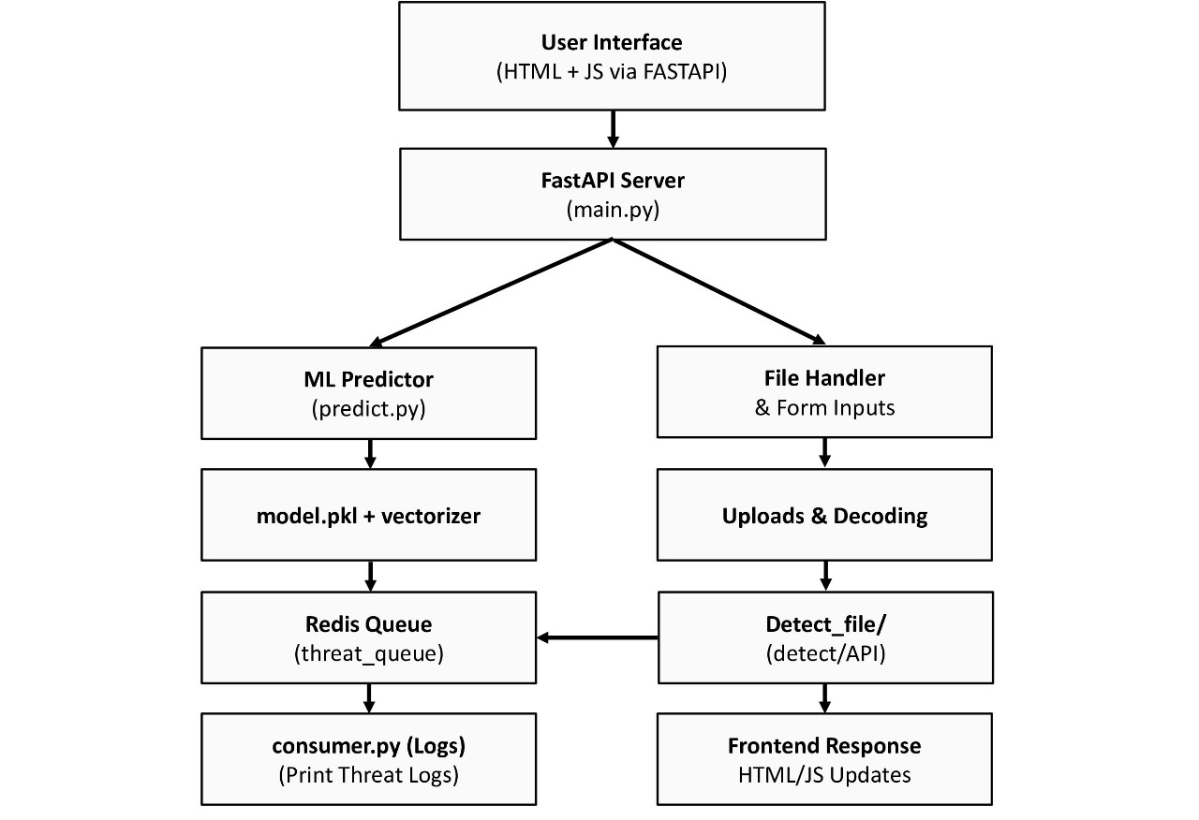
System Architecture

Slide 7
How It Operates (Flow)
The user uploads a file (.txt/.csv) or enters a single payload.
The payload is processed by the backend.
TF-IDF vectorization is used to preprocess and transform the text.
It is categorized as benign, sql, xss, or malicious by the Random Forest model.
The results are logged to Redis and returned to the user interface.
Queue data is logged by consumer.py.

Slide 8
Model Training
RandomForestClassifier is the algorithm.
Input: Label (category), Payload (text)
TF-IDF vectorization as a preprocessing step
~90% accuracy
Pickle was used as a model and saved.Vectorizer.pkl and pkl.
Better than regex at handling unknown or altered payloads.

Slide 9
Features of the Web Interface
constructed with HTML, CSS, and JS.
API calls using the FastAPI backend.
Predictions in real time.
Supports:
-> One input payload.
->Uploading files for bulk classification.
Results are color-coded as SQL, XSS, malicious, and benign.

Slide 10
Docker-Based Deployment
The application was containerized using a Dockerfile.
Using docker-compose to execute:
-> The web server FastAPI
->The Redis server
->Customer service history
Local deployment made easier: docker-compose up --build

Slide 11
Precision and Outcomes
~90% detection accuracy was attained.
Minimal false positives on innocuous data
manages typical payload patterns
Restrictions:
->Not able to identify entirely new attack types.
->Not connected to real traffic sniffers.

Slide 12
Advantages & Limitations
Advantages:
Detection of threats in real time.
Scalable using Docker and Redis.
User-friendly web interface.
Correct SQLi/XSS classification.
Limitations:
Labeled data is necessary for the ML model to function.
No support for encrypted traffic.
Not incorporated into the operational firewall or WAF.

Slide 13
Future Enhancements
For improved generalization, include deeper models (LSTM, BERT).
Make use of a bigger dataset from actual traffic
Add an admin panel or Redis dashboard.
Include SMS and email alerts.
Threat reports can be exported as PDFs.

Slide 14
Tools & Technologies Used
Tools | Technology
Programming | Python
Web Framework | FastAPI
Mi Model | Scikit-learn
Queue System | Redis
Frontend | HTML, CSS,JS
Containerization | Docker, Docker Compose

Slide 15
Conclusion
successfully developed a real-time SQLi and XSS threat detection tool driven by machine learning.
Redis, web frontend, API, and model were all integrated into the full-stack detection system.
Docker deployment was used, and test payloads were used for validation.
An example of applying AI/ML to cybersecurity in practice.

Slide 16
Thank you

